Slide 1





CSD 380: DEVOPS
BARRIERS TO A JUST LEARNING CULTURE
MODULE 9: ASSIGNMENT 2
Jacob Ambrose

Slide 2

Overview
What is a Just, Learning Culture
How is one established
Challenges and Barriers
Overview
Lack of Support
Time
Resources
Resistance
Processes
Works Cited

Slide 3
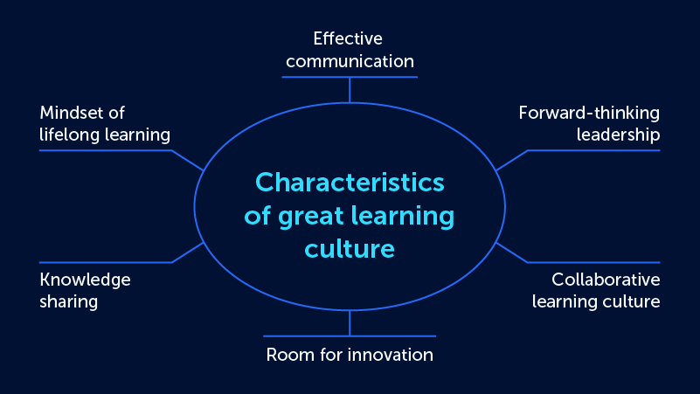
What is a Just, Learning Culture
A Just, Learning Culture is a culture of growth and responsiveness. On a good day no one is perfect, minor mistakes can be made and caught before issues arise. But even when everyone is perfect, issues outside of our control can arise. A Just, Learning culture emphasizes action and response as opposed to reaction.
The end goal of a Just, Learning culture is one where organizations do not blame or shame for mistakes or issues as they arise. Instead, a Just, Learning Culture is focused on providing the tools and resources to minimize mistakes and spend more time on correcting issues as needed.

Slide 4


Establishing a Just, Learning Culture
1
Correcting errors is not a shame game. Managers should focus not on how employees went wrong in an action, but focus on what they can do to be right the next time around.
2
Provide the best tools for the task. If employees are using tools that are error prone then employees are doing double the work increasing odds for errors.
3
Most importantly: A culture of safety. When employees understand that they will not be fired for a single mistake, they are more willing to own up to mistakes and ask for help when they receive the same issue in the future.

Slide 5


Challenges and Barriers Overview
There are various obstacles to overcome when attempting to implement a Just, Learning culture at an organization such as:
Lack of Support
Time
Resources
Resistance
Processes

Slide 6
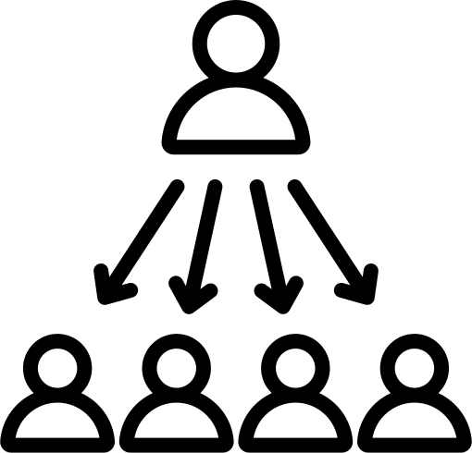
Lack of Support
A culture of learning comes from the top down. Employees need to see that management and above are all actively supporting and living the Just, Learning Culture. It benefits employees to see management and executives walking the walk, so to speak.
This means that leaders and managers need to act as role models, showing the benefits of a Just, Learning Culture so that employees of all levels are empowered to learn and grow.

Slide 7

Time
Not just employees, but managers and leaders need to be provided the time to learn and grow. An organization may need to schedule time for employees to review current information to ensure they are following best practices, ask questions that they are unclear on, and especially time to learn new tools and processes as they become available.

Slide 8
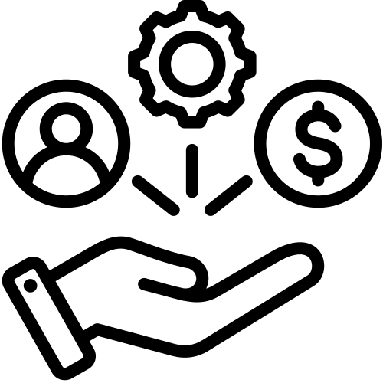
Resources
It is imperative that organizations provide adequate resources for employees of all levels to learn. Asking an accountant to work with paper and pencil only and no additional tools would be making their job more difficult many times over. Providing the correct tools for the job and learning opportunities for those tools will go a long way in creating a Just, Learning Culture.

Slide 9

Resistance
Many experienced employees, managers, and leaders can become resistant to change. Attitudes of “this is how we have always done it” can be prevalent. Learning new tools and skills can often be intimidating, but by working to reassure employees that these changes are for the better and will assist them can help alleviate axiety.

Slide 10

Processes
Previous challenges have included: Time, resources, and resistance, but also the organization’s day-to-day processes are needing to reflect a desire for a Just, Learning Culture. If all other tools are provided, but the processes for any mistake are still punitive and not growth oriented, then a safe culture of learning is not being facilitated. Ensure that processes are set so that mistakes are learned from and responded to as opposed to reacted to.

Slide 11
Works Cited
Dickinson, T. (2020, July 16). 6 obstacles to a learning culture-and how to avoid them. Watershed Insights RSS. https://www.watershedlrs.com/blog/learning-culture/6-barriers-to-creating-a-learning-culture/
Fitch, D. (2023, December 8). Creating a thriving learning culture: Four obstacles to overcome. Home. https://www.peoplemanagement.co.uk/article/1850423/creating-thriving-learning-culture-four-obstacles-overcome
Mills, D., & Kuzmina, J. (2022, September 16). Learning culture: 10 steps to build it in 2024. Valamis. https://www.valamis.com/blog/learning-culture
Zahair, A. (2023, December 1). Creating a thriving learning culture: Four obstacles to overcome. CEO Monthly. https://www.ceo-review.com/creating-a-thriving-learning-culture-four-obstacles-to-overcome/

